Slide 1
Online Food Delivery Application

Slide 2
Technologies
Java 8
Spring Boot
Spring Security
Angular | React
PostgreSQL | MYSQL
Maven | Gradle

Slide 3
Problem Statement
The Aim of this application is to form a bridge between restaurant and customers.
The Restaurant owners must be able to sign in to the application to create and list out their food items along with the price
So, that the customers could sign up , view the nearby restaurants and place the order.
The customer selects the method of payment and makes a payment for his order.
The restaurant owner can accept his order and delivery the order to customer.

Slide 4
Plan
Design
Generate the skeleton as per class design provided
TDD approach
Identify test cases for each module
Write Failing Test cases
Convert the Test Cases in GREEN
Implement the case study in incremental manner

Slide 5
Modules
Login Module
Customer Module
Restaurant Module
Order Module
Bill Module

Slide 6
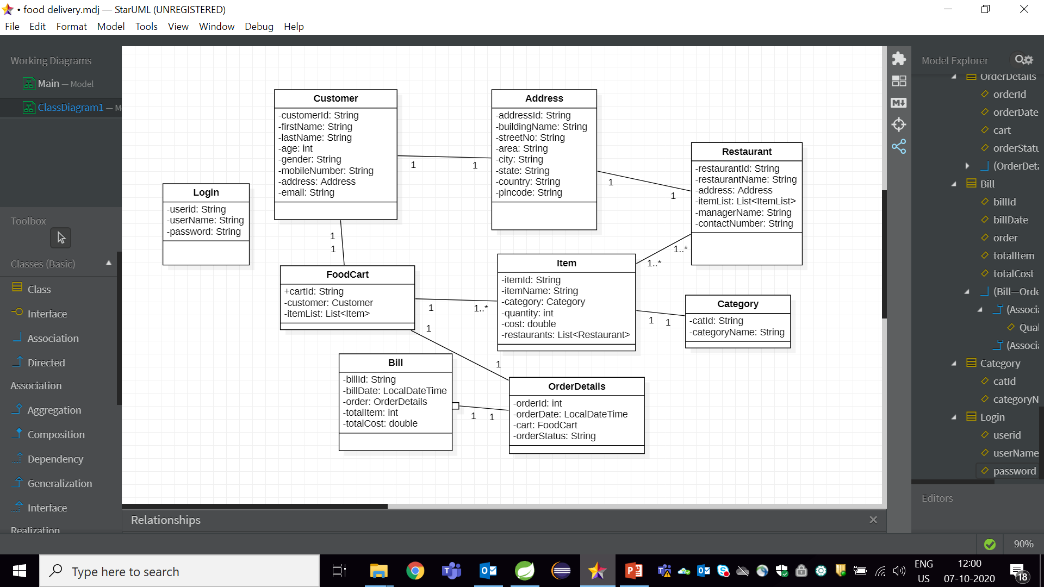
Class Design [POJO Classes]

Slide 7
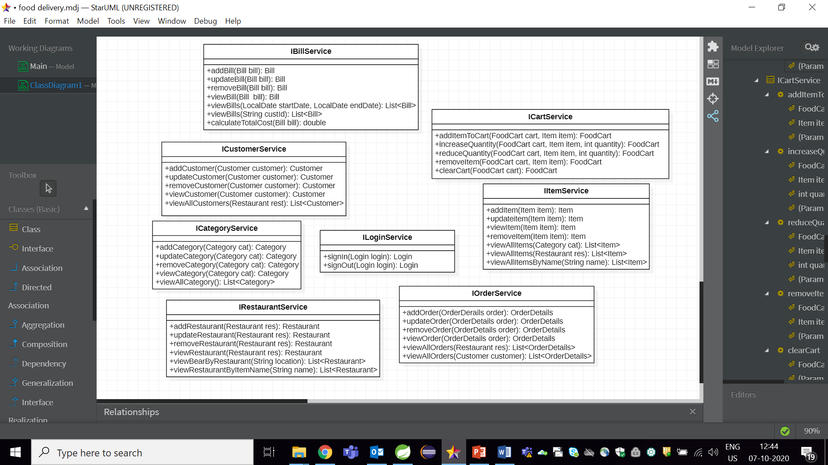
Class Design [Service Interface]

Slide 8

Class Design [Repository]

